Slide 1
Reviewing Photoshop Part 1
Complete this entire tutorial before moving on to the next step

Slide 2
Click on the blue PS button on your desktop

Slide 3
It will look like this when opened

Slide 4
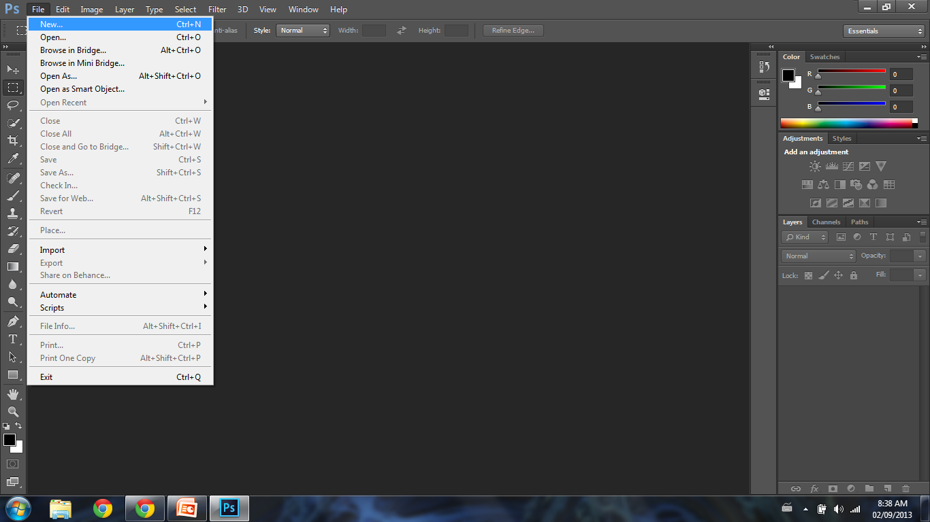
To make a new document click FILE and NEW

Slide 5
Change the info in the dialog box to match below. (Same size as a piece of paper)

Slide 6
This is your CANVAS

Slide 7
Creating Layers
Click the little folded piece of paper as many times as you need.

Slide 8
Deleting Layers
Click the garbage can to delete, or press DELETE on your keyboard

Slide 9
Renaming Layers
Double-click on the layer name to rename it. This will help keep track of your layers.

Slide 10
Hiding Layers

Slide 11
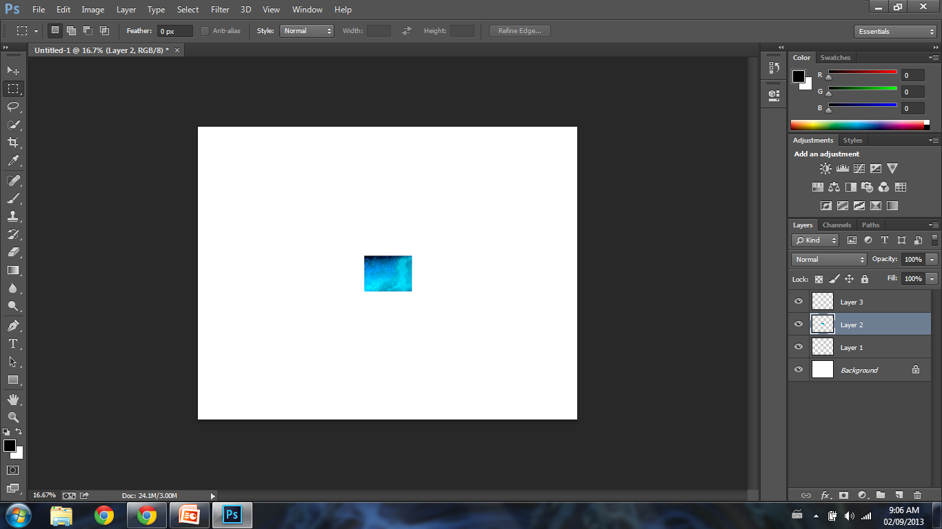
Pasting Images CTRL + V

Slide 12
Transforming Images CTRL + T
Hitting CTRL + T will allow you to resize and rotate. You can also right-click for more option like warp, and flip. When finished your transformation hit ENTER

Slide 13
History
History allows you to go back and forth but will only remember from when you saved last.
The shortcut for history is
CTRL+ALT+Z

Slide 14
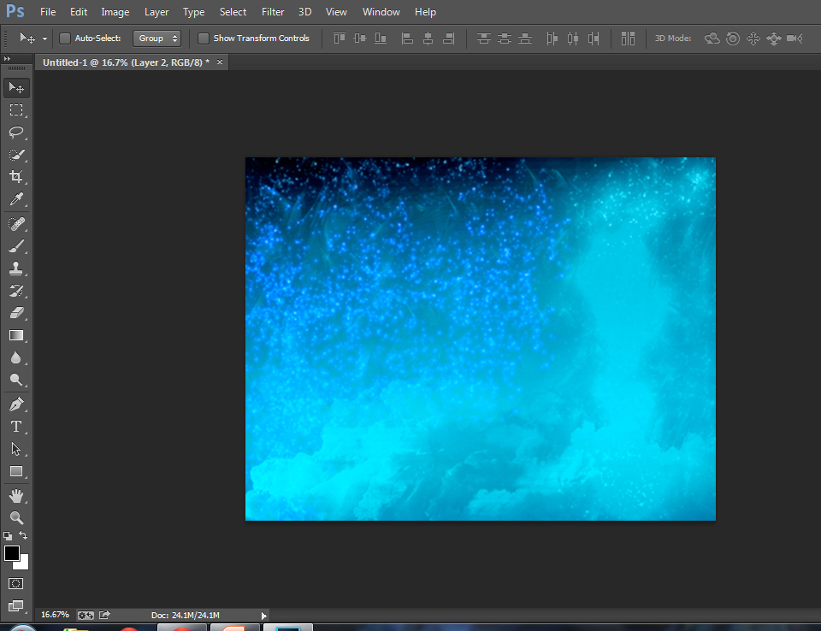
Move Tool
Allows you to move objects around.

Slide 15
Marquee Tool
Allows you to select shapes. Clicking and holding on the marquee tool will allow you to change the shape of the marquee. Click and drag the shape onto the canvas.

Slide 16
Deleting inside PRESS DELETE

Slide 17
Deleting Outside CTRL+SHIFT+I then press DELETE

Slide 18
Deselecting Marching Ants CTRL + D

Slide 19
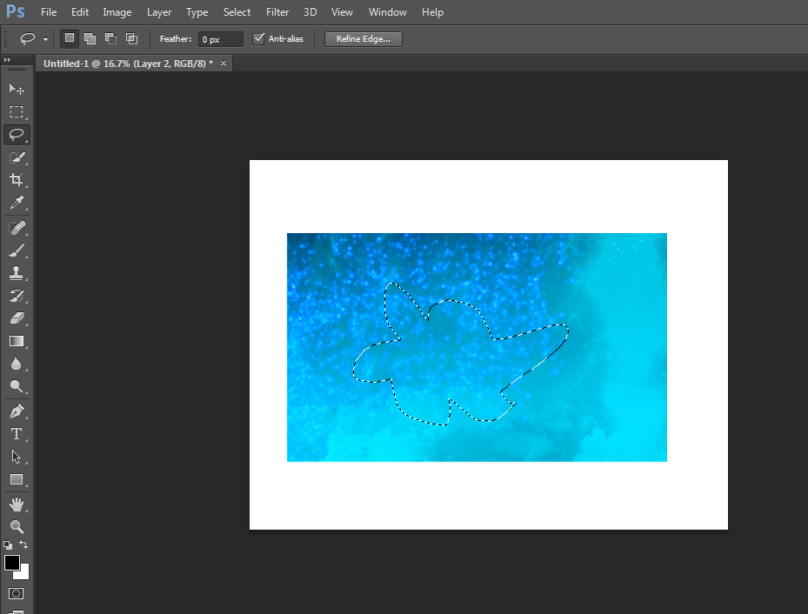
Lasso Tool
Allows you to freehand a shape.

Slide 20
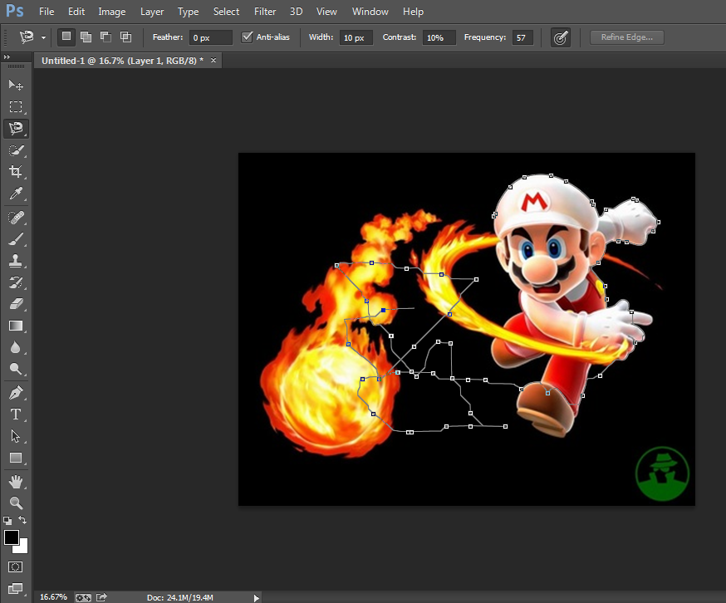
Magnetic Lasso
Allows you to follow an object closely attaching itself to you object based on color. If it veers off, and goes everywhere, just hit ENTER. Make sure to finish the same place you started.

Slide 21
Quick Select
Click and drag over an area to quick-select. If you find that it has selected an area you don't want it to select, hold down ALT and drag you mouse over the area you wish to deselect.

Slide 22
Magic Wand
Allows you to select a whole area based on color.

Slide 23
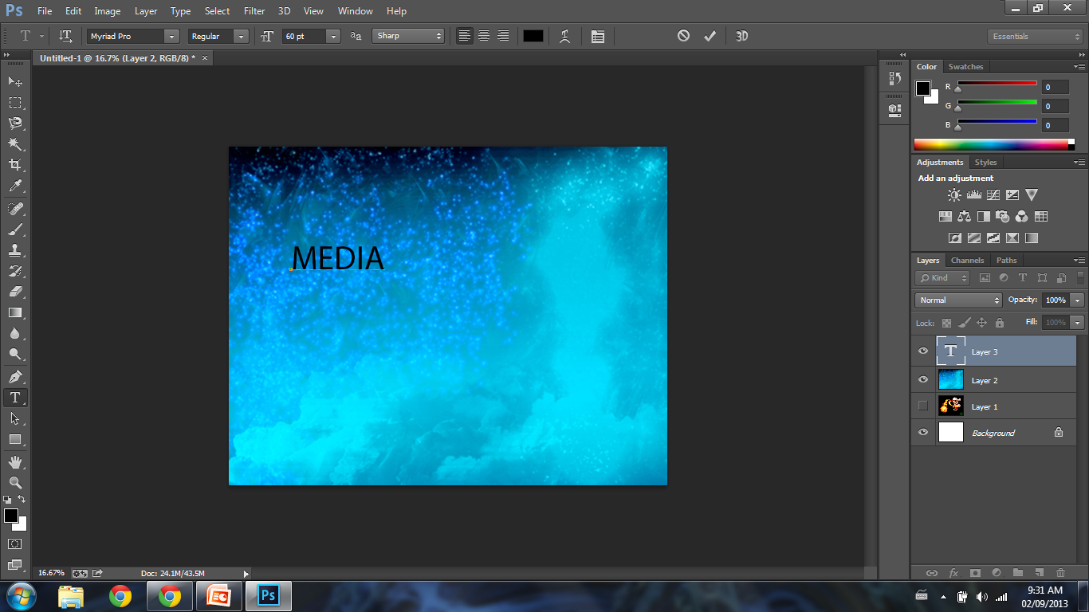
Type Tool
OPTIONS BAR
Click on the Type tool, then click on the canvas and start typing. To make changes to your text, highlight first, then use the options bar up at the top.

Slide 24
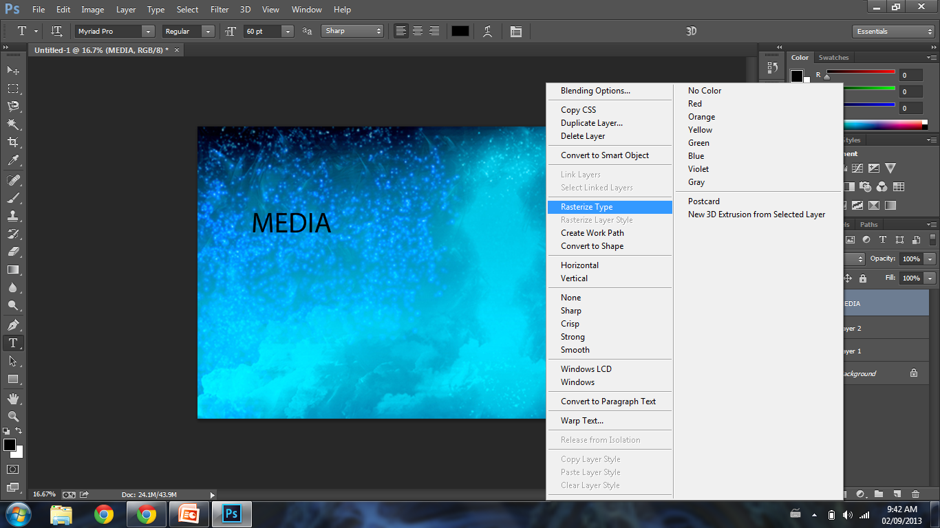
Rasterizing type
To rasterize your text, right click on the layer and hit rasterize type. This will turn your text into a picture so that you can add filters, and transform it.

Slide 25
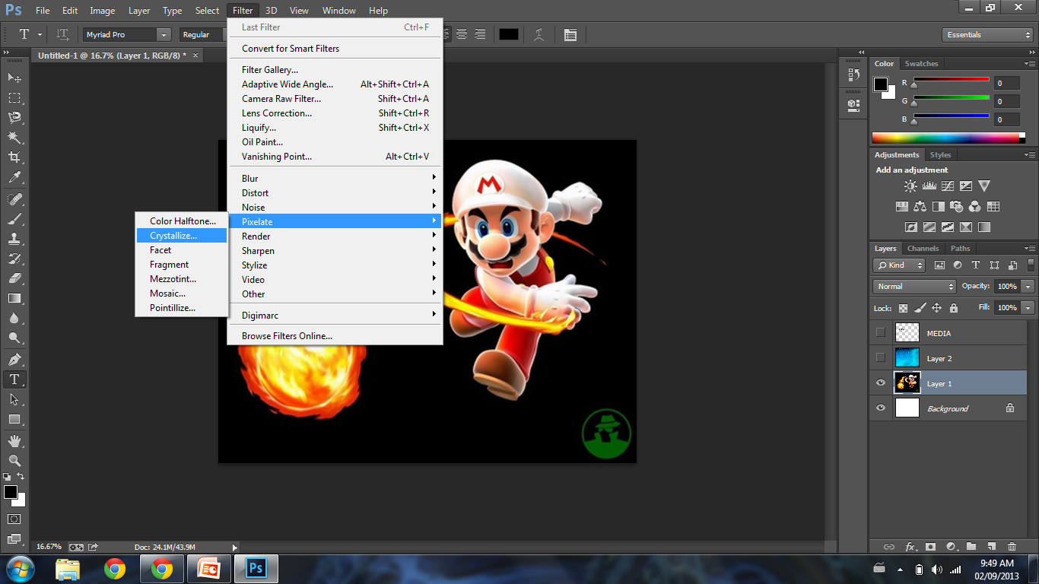
Filters
Filters will alter your image in interesting and unique ways. The filter gallery is also a good place to alter your image.

Slide 26
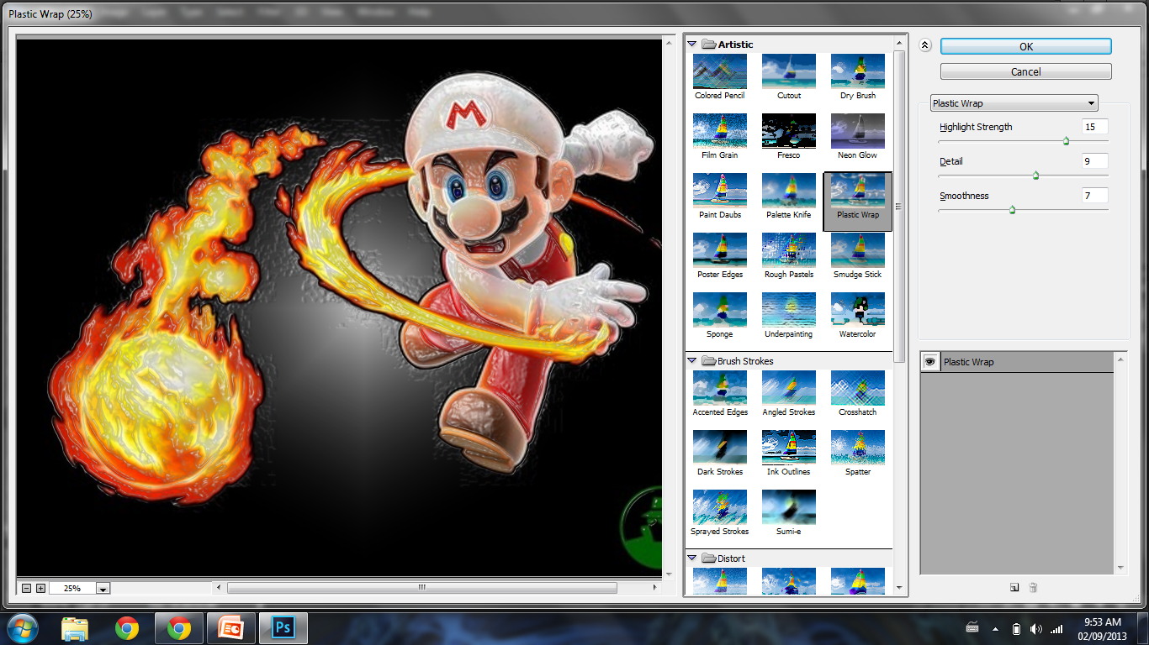
Filter Gallery
Click Filters, and then Filter Gallery

Slide 27
Adjustments Panel
The adjustments panel allows you to add layers that will adjust the image.(Black &White, Hue Saturation, curves, gradients, etc.)

Slide 28
These are all the Photoshop basics. Once you have refreshed your memory, take the quiz!

